Slide 1

CYBERSECURITY How (Not) to Get Hacked
And Why protecting your digital identity matters
By David Štencel

Slide 2
Introduction
Every day, millions of accounts are hacked.
Cybercriminals target personal data, money, and privacy.
How easy is it to get hacked? And how can you stay safe?
Today, we will cover:
✅ How hackers steal passwords ✅ The biggest mistakes people make ✅ How to protect yourself ✅ Real-life hacking incidents
By the end, you’ll know how to make your online life more secure!

Slide 3
How hackers obtain passwords?
1️⃣ Phishing
➡ Fake emails & websites pretending to be real ➡ Example: "Your bank account is at risk! Click here to verify your login." ➡ Many people fall for this trick!
2️⃣ Keyloggers
➡ Malicious software records everything you type. ➡ Hackers steal passwords without you knowing!
3️⃣ Data Breaches
➡ Websites get hacked, and your passwords get leaked. ➡ If you reuse passwords, hackers can access all your accounts!

Slide 4
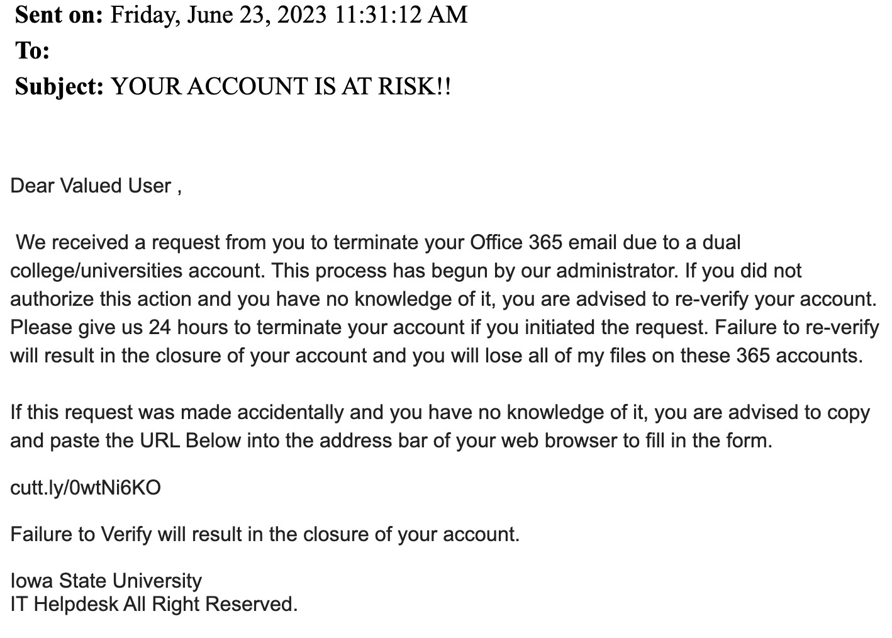
Phishing – Real Example
Example of phishing e-mail
🛑 How to recognize phishing emails:
✅ Suspicious sender (weird email address or phone number) ✅ Urgent tone ("Immediate action required!") ✅ Bad spelling or grammar ✅ Link looks strange (hover over it before clicking!)
👉 Never click suspicious links or open unknown attachments!

Slide 5
The Biggest Mistakes Users Make
❌ Weak passwords – "123456", "password", "qwerty" ❌ Same password for everything – One leak = all accounts hacked ❌ No Two-Factor Authentication (2FA) – Extra security layer missing
🔑 Hackers love lazy users! Don’t make their job easy!

Slide 6
20 most commonly used passwords in the Czech Republic
Order | Password | Password cracking time | Number of occurrences
1. | 123456 | < 1 second | 4 142
2. | 123456789 | < 1 second | 1 747
3. | 12345 | < 1 second | 1 049
4. | qwerty123 | < 1 second | 1 037
5. | heslօ | 10 seconds | 978
6. | martin | < 1 second | 866
7. | qwerty1 | < 1 second | 862
8. | password | < 1 second | 719
9. | slunicko | 3 hours | 510
10. | maminka | 17 minutes | 502
11. | michal | 2 minutes | 501
12. | milacek | 17 minutes | 495
13. | veronika | < 1 second | 451
14. | monika | 2 minutes | 444
15. | beruska | 17 minutes | 441
16. | martina | 13 seconds | 438
17. | 12345678 | < 1 second | 418
18. | lenka | 10 seconds | 385
19. | 111111 | < 1 second | 378
20. | sparta | < 1 second | 344

Slide 7
How to Protect Yourself – Strong Passwords
✅ Use long, unique passwords (12+ characters) ✅ Mix uppercase, lowercase, numbers, and symbols ✅ Never reuse passwords! ✅ Use a password manager (LastPass, 1Password, KeePass)
💡 Example of a strong password: hG8$wK1!zP4&nT7
https://www.eset.com/us/password-generator/

Slide 8
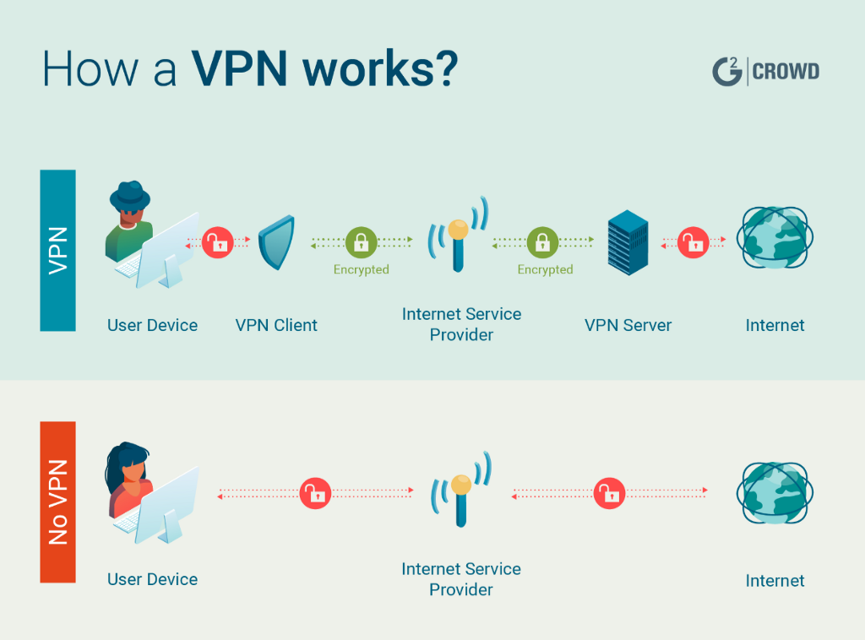
Two-Factor Authentication (2FA) & VPN
🔒 2FA – Your Secret Weapon
✅ Even if hackers get your password, they can’t log in! ✅ Use authentication apps (Google Authenticator, Authy) instead of SMS.
🌍 VPN – Secure Your Internet
✅ Encrypts your connection, especially on public Wi-Fi. ✅ Prevents hackers from spying on your online activity.
Proton VPN (also available for free), Mullvad VPN, Nord VPN
💡 Example: Using free airport Wi-Fi? Hackers could be watching! Use VPN.

Slide 9
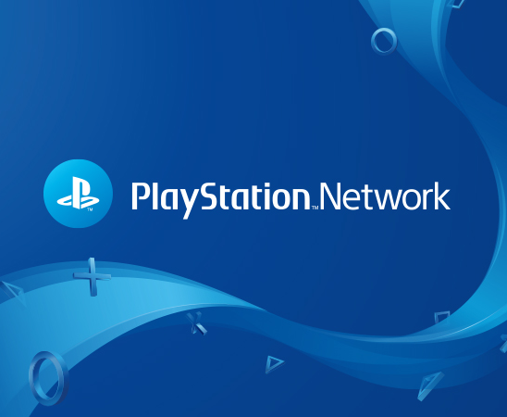
Famous Hack – Sony PlayStation Network (2011)
🎮 What happened?
Hackers stole data from 77 million accounts.
Personal info, credit cards, and passwords were compromised.
PlayStation Network was offline for 23 days.
🚨 Lesson: Even big companies can get hacked. Stay protected!

Slide 10
How NOT to Handle Cybersecurity – A Real-Life Example
Cybersecurity is not just about protecting passwords or avoiding phishing scams. It's also about how organizations handle sensitive personal data. And today, I want to show you a real-life example of what happens when they don’t.
Imagine a university offering an extra IT course for students. That sounds great, right? Until you look at the payment instructions.
To enroll, students must pay a fee – and use their birth number (equivalent to a Social Security Number) as a payment reference!
This is a perfect example of what NOT to do in cybersecurity.

Slide 11
Why is This a Problem? What Should They Do Instead?
Birth numbers are highly sensitive personal data. 👉 They can be misused for identity theft. 👉 Publicly exposing them in transactions increases the risk of data breaches. 👉 Best practice? Never use personal identifiers in financial transactions.
Instead, they should:
Use a randomly generated reference number for payments.
Ensure personal data is encrypted and not exposed in transactions.
Follow GDPR and best practices in cybersecurity.

Slide 12
Summary & Final Tips
✅ Use strong, unique passwords ✅ Enable Two-Factor Authentication ✅ Never click suspicious links ✅ Use a VPN on public Wi-Fi
💡 Final question:
Will YOU change your passwords today? Don’t wait until it’s too late!
🙏 Thank you for your attention – and remember, always think before you share your data!

